Slide 1

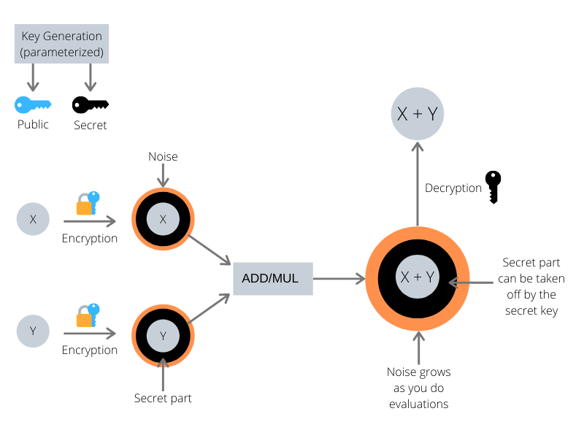

Homomorphic Encryption
AUTHORS
INTRODUCTION
METHODOLOGY
ANALYSIS
CONCLUSION
Homomorphic encryption is a special type of encryption that enables computations to be performed directly on encrypted data without compromising the encryption
Homomorphic Encryption represents a groundbreaking advancement in data security and privacy.I ts potential impact across industries and ongoing advancements position it as a transformative technology for secure computation on Conclusion
Compute on encrypted data
No decryption needed, result stay encrypted
Compute on encrypted data
No decryption needed, result stay encrypted
Analyze sensitive data in the cloud without compromising confidentiality
BACKGROUND
MODELS
There are different types of Homomorphic
Encryption, including partially
homomorphic and fully homomorphic
encryption schemes.
RECOMMENDATIONS
1970: Born as a theoretical concept , compute on encrypted data
1990: Early schemes could only add or multiply encrypted numbers
2009: Fully Homomorphic Encryption (FHE) arrives
In PHE, only one type of operation (eg. Addition or multiplication ) can be performed on the encrypted data while preserving its integrity
FHE schemes allow arbitrary computations to be performed on encrypted data, including additions , multiplication and combination theory without knowing the decryption key
Use FHE for all math operations on encrypted data
Choose PHE for specific operations
IMPLICATIONS
RESULTS
Boost security and privacy in healthcare, finance and more
Leverage cloud power for secure analysis
OBJECTIVES
Perform computations directly on encrypted data.
No decryption needed , enhancing security and privacy.
Analyze sensitive data in the cloud without compromising confidentiality.
ACKNOWLEDGEMENTS
Grateful for guidance from our project guide, support from our team members, resources from VIT and insights from academia.

